Slide 1

Student Ambassador Projects
CleanCapture
Notes:
Korrie

Slide 2
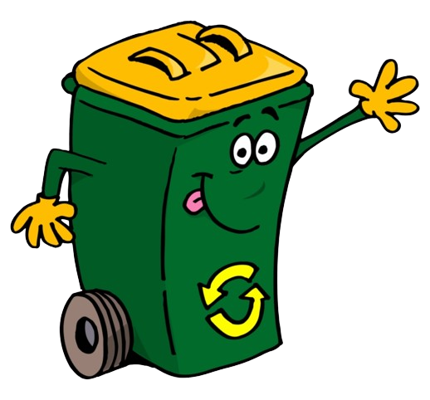
CleanCapture
BrainPhoto Team
⁠Jaures Beinjamin FOTSING
Ridwan Abdurahman
Hasan Jehangir
Notes:
Korrie

Slide 3

Problem Statement
Global Waste Management Challenges
Landfill Overuse: Rapidly growing landfills are consuming valuable land and contributing to long-term environmental hazards.
Eutrophication: Runoff from landfills causes nutrient pollution, harming aquatic ecosystems.
Toxic Waste Consumption: Animals ingest waste, leading to bioaccumulation of toxins.
Leachate Contamination: Hazardous liquids from landfills seep into soil, threatening groundwater.
Pollution: Improper waste management leads to widespread air, water, and soil pollution.
Notes:
Korrie
updated 7/21

Slide 4
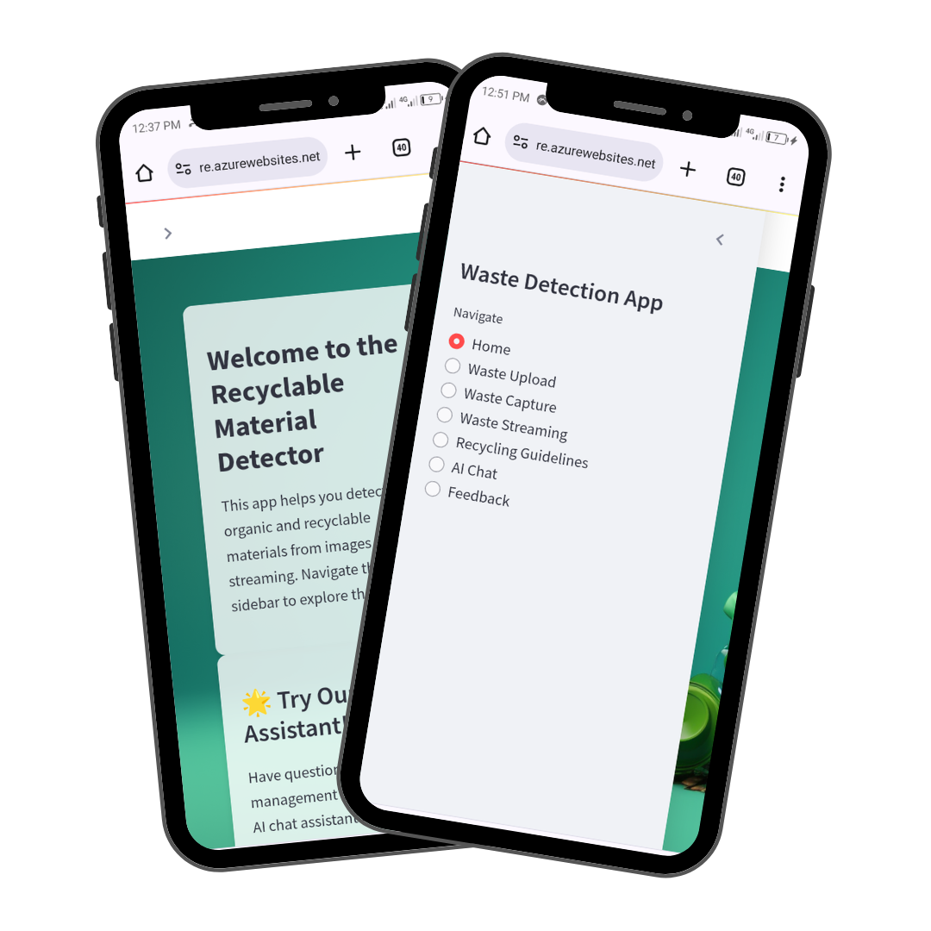
Solution
Why We Built CleanCapture
CleanCapture was developed out of a need to improve waste management practices globally. The core idea is to harness the power of AI to automatically detect and classify waste into organic, recyclable, and non-recyclable categories.
Key Features
Waste Detection: Users can capture or upload images of waste materials. The app uses Azure Custom Vision to accurately detect and classify waste types.
Recycling Guidelines: The app includes guidelines on proper waste disposal, encouraging users to adopt sustainable practices.
AI Chat Integration: Interactive support for waste management queries. users can engage with an AI chatbot to get real-time advice on waste management. This feature enhances user experience by providing instant, personalized support.
User-Friendly Interface: The app is designed with simplicity in mind, allowing users to navigate, upload images, and receive classifications easily.
Notes:
Korrie
updated 7/21

Slide 5


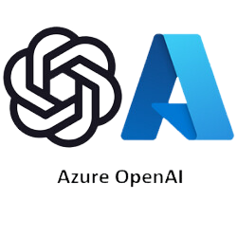

Technology Stack
Technology Behind Clean Capture
Azure Custom Vision: Used for training the waste detection model with high precision.
Azure OpenAI: Powers the AI Chat feature, providing users with real-time advice and support on waste management.
Streamlit: The framework used to develop the web application, enabling rapid development and a user-friendly interface.
Deployment on Azure Web App Services: The entire application is deployed on Azure, ensuring scalability and availability.
Notes:
Korrie
updated 7/21

Slide 6
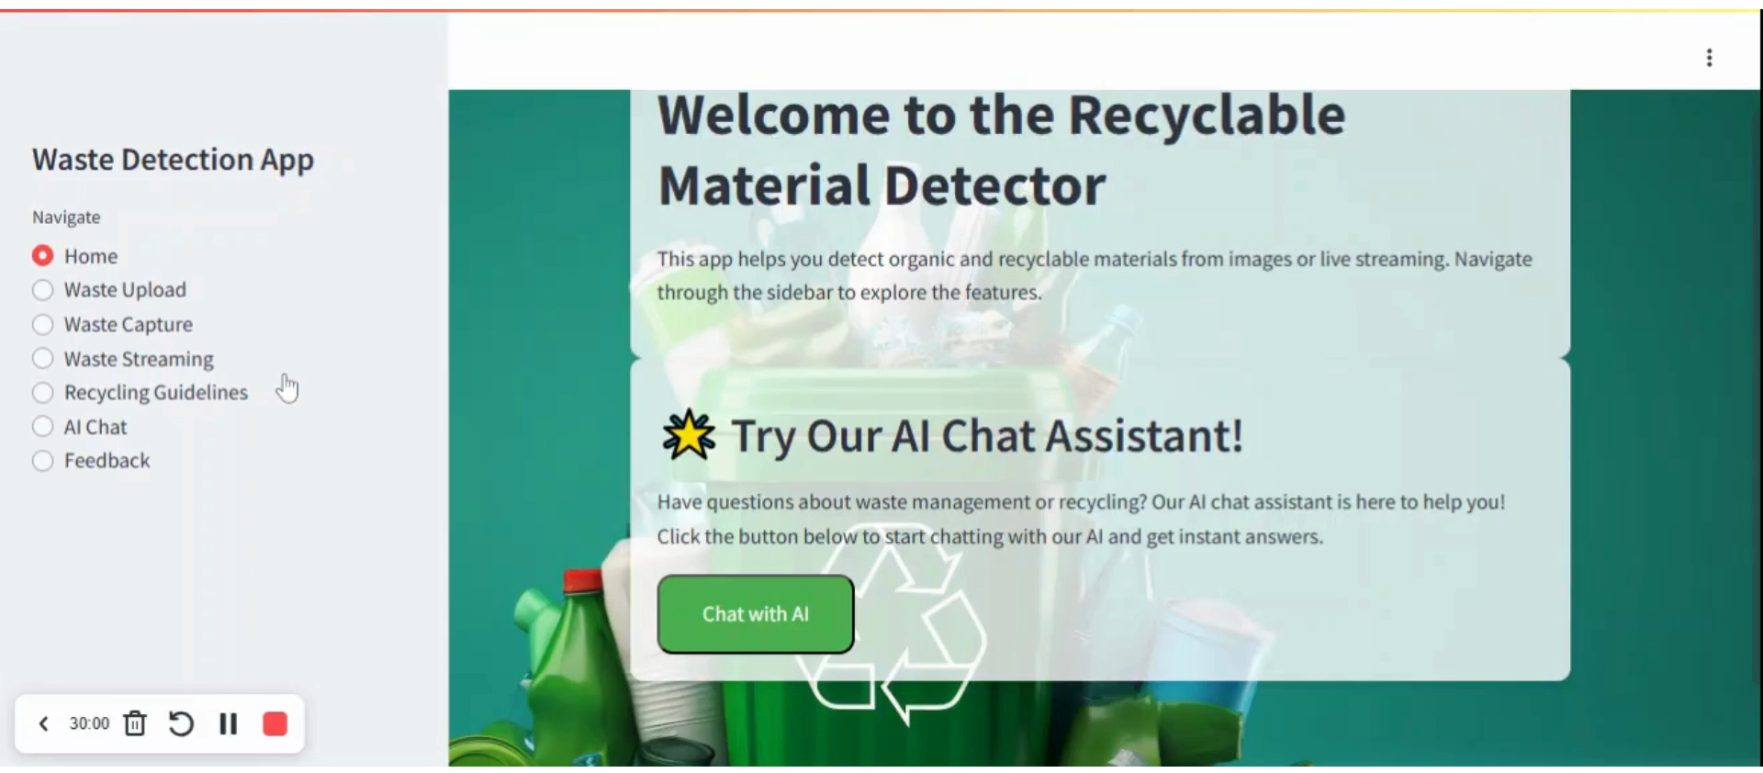
Demo

Slide 7
Takeaways
Recommendations:
Start Implementing Automated Waste Solutions: By adopting AI-driven waste management systems like Clean Capture, organizations can significantly reduce environmental impact.
Educate and Engage Users: Encourage the use of AI chat features to promote better waste management practices.
Leverage AI for Efficiency: Automating waste detection can save time, reduce costs, and improve accuracy in waste management efforts.
How CleanCapture Helps::
Simplifies Waste Management: Clean Capture offers a user-friendly, scalable solution that simplifies the process of waste detection and classification.
Promotes Environmental Sustainability: By improving recycling rates and reducing landfill dependency, Clean Capture contributes to a greener planet.
Notes:
Korrie
updated 7/21

Slide 8
Conclusion
Clean Capture is more than just a tool—it's a step towards a sustainable future. With AI-powered waste management, we aim to make the world cleaner, one piece of waste at a time.
Notes:
Korrie
updated 7/21

Slide 9
CleanCapture
https://cleancapture.azurewebsites.net/
Thank You !!!
Notes:
Korrie

